Slide 1
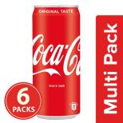
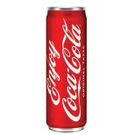
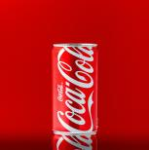
coca cola 6*300ml = 210/-

Slide 2
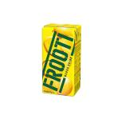
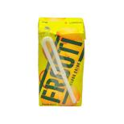
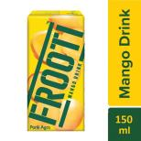
Frooti Drink - Fresh 'N' Juicy Mango, 150 ml Tetra
10/-

Slide 3
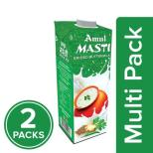
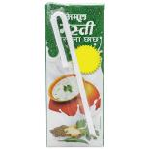
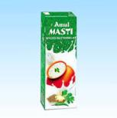
Masti Butter milk
10/-

Slide 4
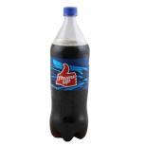
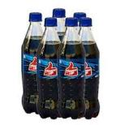
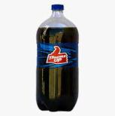
Thumbs up
2L = 90/- , 40/- small bottle

Slide 5
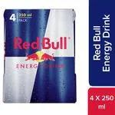
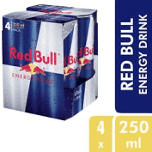
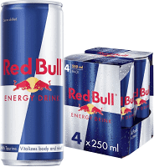
Red bull 250ml(4 pack) 399/-

Slide 6
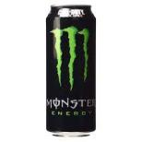
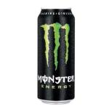
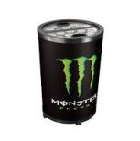
Monster 350ml 97/-

Slide 7
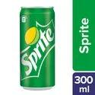

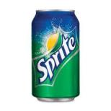
sprite 300ml 40/-

Slide 8
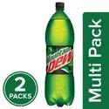
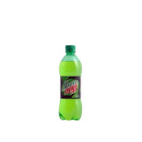
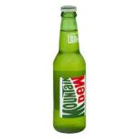
Mountain dew 2.25*2ml 128/-
1 bottle 20/-

Slide 9
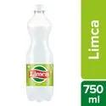
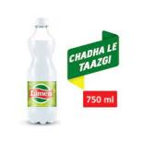
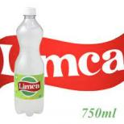
Limca 750ml 40/-

Slide 10
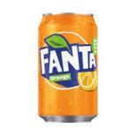
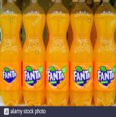

fanta 2l 90/-

Slide 11
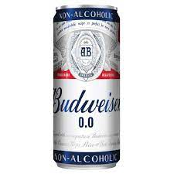
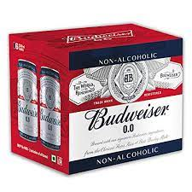
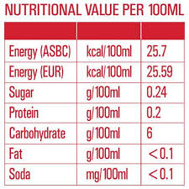
Budweiser 0.0 6*330ml 480/-

Slide 12
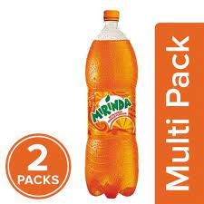
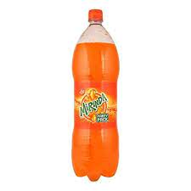
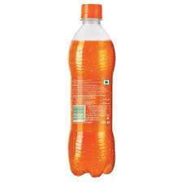
Mirinda 2*2.5ml 180/-

Slide 13
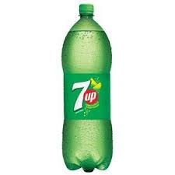
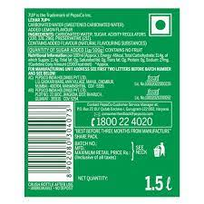
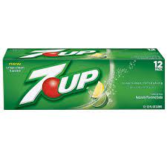
7 up-lemon 24*250ml 720/-

Slide 14
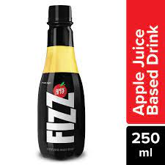
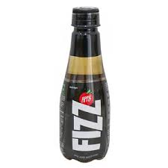
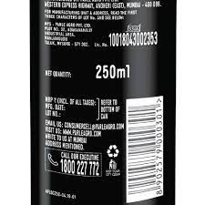
Appy fizz 250ml 15/-

Slide 15
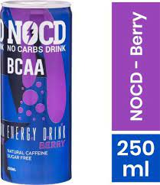
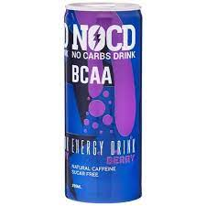
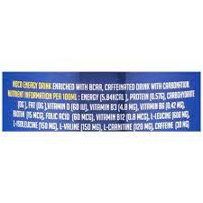
Nocd-berry flavour 250ml 110/-

Slide 16
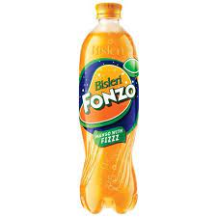
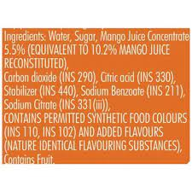
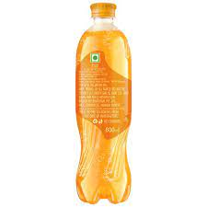
Fonzo-mango with fizz 600ml 40/-

Slide 17
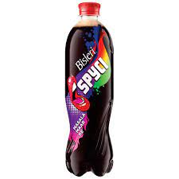
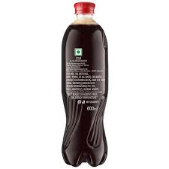
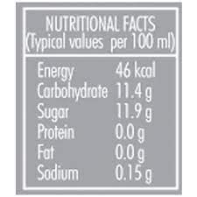
Spcyi-masala maar ke 600ml 40/-

Slide 18

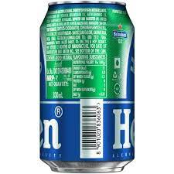

Heineken 300ml 75/-

Slide 19



Radler-mint&lime 6*300ml 243/-

Slide 20



&stirred-Cosmopolitan (cranberry and orange)
125ml 50/-

Slide 21



Bindu- soda fizz (jeera masala)
600ml 35/-

Slide 22



Hoegaarden 0.0 330ml 100/-

Slide 23



Gatorade –orange flavour 3*500ml 150/-

Slide 24



Tropicana- mixed fruit delight 1l 110/-

Slide 25



Paper boat-coconut water 4*200ml 200/-

Slide 26



Raw presser-Valencia orange 3*1l 890/-

Slide 27



Sofit- soya milk (vanilla) 3*200ml 94,67/-

Slide 28



So good-almond fresh natural 3*200ml 178.5/-

Slide 29



Minute maid-pulpy orange 1l 70/-

Slide 30



Real-cranberry 1l 103/-

Slide 31



Tang-orange 500g 127/-

Slide 32



Hersheys milkshake-orange 3*200ml 87.47/-

Slide 33


Tropicana Slice mango drink 1.2l 65/-

Slide 34



Cavins chocolate milkshake 3*200ml 94.63/-

Slide 35



Maaza mango juice 1.5l 73/-

Slide 36



Nandini spiced buttermilk 200ml 10/-

Slide 37



Schweppes indian tonic water 300ml 50/-

Slide 38



Red label natural care tea 500g 305/-

Slide 39



Taj mahal tea 2*200g 720/-

Slide 40



Tata tea gold 500g 315/-

Slide 41



Cothas coffee 500g 240/-

Slide 42



Nescafe sunrise coffee 9g 10/-

Slide 43



Bournvita chocolate health drink 2*750g 570/-

Slide 44



Bru instant coffee 2*50g 120/-

Slide 45



Horlicks classic malt 500g 229/-

Slide 46



Boost nutrition drink 750g 351/-

Slide 47



Wagh bakri leaf tea 250g 135/-

Slide 48



Tata tea Kannan devan 500g 158/-

Slide 49



Society tea 250g 135/-

Slide 50



bayars Kohinoor tea royal 500g 200/-

Slide 51



carrot 500g 30/-

Slide 52



Mushrooms-button 1pack 180g-200g 48/-

Slide 53



Beetroot 250g 7.50/-

Slide 54



Beans-haricot 1kg 79/-

Slide 55



Sweet corn 2pc 28/-

Slide 56



Methi 1kg 79/-

Slide 57



Brinjal 1kg 39/-

Slide 58



Ridge gourd 500g 25/-

Slide 59



Mint leaves 1kg 79/-

Slide 60



Broccoli 1pc 250g-500g 33/-

Slide 61



Spring onion 100g 14/-

Slide 62



Radish white 1kg 25/-

Slide 63



Drumstick 250g 20/-

Slide 64



Amla 250g 46/-

Slide 65



Sweet potato 1kg 39/-

Slide 66



Coccinia 500g 20/-

Slide 67



Bitter gourd 1kg 45/-

Slide 68



Bottle gourd 1pc 500g-800g 15/-

Slide 69



Colocasia 1kg 49/-

Slide 70



Beans-broad 1kg 59/-

Slide 71



Chow chow 500g 26/-

Slide 72



Pumpkin 1pc 29/-

Slide 73



Onion 1k 30/-

Slide 74



Potato 1k 20/-

Slide 75



tomato 1k 20/-

Slide 76



green capsicum 1k 21/-

Slide 77



cauliflower 400g-600g 13/-

Slide 78



garlic 250g 33/-

Slide 79



Fresh Coriander Leaves 100g 9/-

Slide 80



fresh cabbage 500g 9/-

Slide 81



fresho cucumber 500g 16/-

Slide 82



Ladies finger 500g 9/-

Slide 83



Palak 250g 23/-

Slide 84



Fresh Watermelon - Striped, Large, 1 pc 3.5kg -5 kg
85/-

Slide 85



Fresh Pomegranate - Small, 1 kg
199/-

Slide 86



Pear-green,imported 2cs 119/-

Slide 87



Fresh Fresh Figs, 250 g
45/-

Slide 88



Fresh Papaya - Medium, 1 pc 1 kg - 1.5 kg
37/-

Slide 89



Fresh grapes, 500g 36/-

Slide 90



Fresh kiwi, 400g 100/-

Slide 91



Fresh apple, 4 peace 160/-

Slide 92



Guava 500g 40/-

Slide 93



Muskmelon-striped 1pc 36/-

Slide 94



Fresh coconut, 1 peace 33/-

Slide 95



Fresh banana, 1 kg 52/-

Slide 96



Orange-imported 4pcs 63/-

Slide 97



Fresh Mango, 1 kg 110/-

Slide 98



Sapota 500g 30/-

Slide 99



Pineapple 1pc 750g-800g 45/-

Slide 100



Avocado 1kg 199/-

Slide 101



Snickers Peanut Filled Chocolate Bar, 45 g Pouch
35/-

Slide 102



Epigamia Greek Yogurt - Natural, 90 g
40/-

Slide 103



BORGES Extra Virgin Olive Oil, 1 L Pet Bottle
697/-

Slide 104



Bragg Organic - Apple Cider Vinegar, 473 ml
640/-

Slide 105



Figaro Pure Olive Oil, 2 L Tin
1299/-

Slide 106



Dabur Hommade - Coconut Milk, 3x200 ml Multipack
225/-

Slide 107



Puro Salt - Unrefined, 100% Natural, 1 kg
99/-

Slide 108



Happy Chef Penne Pasta - Whole Wheat, 2x500 g Multipack 175/-

Slide 109



Happilo 100% Natural - Californian Almonds, 200 g
184/-

Slide 110



REGENCY Anjeer - Premium, 200 g
288/-

Slide 111



Yoga bar 100% Pure Cashew Butter, 400 g
599/-

Slide 112



Cornitos Nacho Crisps - Sizzlin Jalapeno, 150 g Pouch
80/-

Slide 113



GoodDiet Mini Puffs - Cheese N Herbs, 5x30 g (Multipack)
70/-

Slide 114



BORGES Durum Wheat Pasta - Spaghetti, 500 g Pouch
125/-

Slide 115



Gery Gone Mad Crackers - Coconut, Family Pack, 110 g 10 Crackers 54/-

Slide 116



Fresho Signature Just Berries, 2x50 g Multipack
188/-

Slide 117



REGENCY Cranberry - Slices, Dried, 200 g
165/-

Slide 118



GoodDiet Multigrain Puffs - Butter Makhana, 5x30 g (Multipack)
70/-

Slide 119



Gery Gone Mad Crackers - Cheese & Sugar, 20 g
10/-

Slide 120



GoodDiet Multigrain Chips - Sour Cream & Onion, 5x30 g (Multipack) 70/-

Slide 121



Nutella hazelnut spread with coco
350g 380/-

Slide 122


Bb royal organic wild forest honey
2*500g 574/-

Slide 123



Disano olive oil extra virgin
1l 599/-

Slide 124



Kara coconut milk uht natural
4*200ml 252/-

Slide 125



American garden natural vinegar white
2*473ml 330/-

Slide 126



Yoga bar whole grain breakfast muesli dark chocolate +cranberry
700g 424.15/-

Slide 127



Ferrero rocher chocolate 16pcs box 529/-

Slide 128



Gone mad choco stick chocolate 288g 24sticks 108/-

Slide 129



Mars nougat and caramel filled chocolate bar
51g 40/-

Slide 130



Latte chocopie premium quality
56g 25/-

Slide 131



Bounty 28.5g 50/-

Slide 132



Lindberg pure belguim cranberries dark chocolate bar
3*50g 339.15/-

Slide 133



Cadbury caramel spread 400g 650/-

Slide 134



Hershey’s kisses milk chocolate 150g 650/-

Slide 135



Fresho signature just berries 2*50g 188.20/-

Slide 136



Regency sunflower seeds 100g 80/-

Slide 137



4700 bc caramel popcorn Himalayan salt
60g 44.10/-

Slide 138



Anmara gluten free fusilli
250g 495/-

Slide 139



Nongshim shin red super spicy noodles
120g 99/-

Slide 140



Habanero penne pasta premium durum wheat
500g 127.50/-

Slide 141



San remo gluten free spaghetti
350g 425/-

Slide 142



Wingreens farms durum wheat pasta elbow macaroni
400g 175/-

Slide 143



Del monte pasta farfalle
2*500g 258/-

Slide 144



Habit black sliced olives
430g 180/-

Slide 145



Daucy extra fine green peas
400g 202.50/-

Slide 146



Bengamese tamarind pickle 200g 199/-

Slide 147



Abbies chickpeas in brine 400g 90/-

Slide 148



Olicoop green pitted olives
450g 240/-

Slide 149



Nectar valley baking powder 250g 198/-

Slide 150



Urban platter chef’s secret seasoning mix 80g 350/-

